Slide 1
Containers and Docker
William Killian
CSCI 380 – Operating Systems

Slide 2
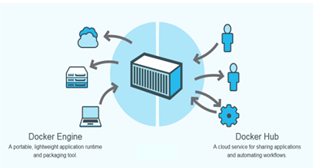
Docker
Open platform for developers and system administrators to build and test cloud applications

Slide 3
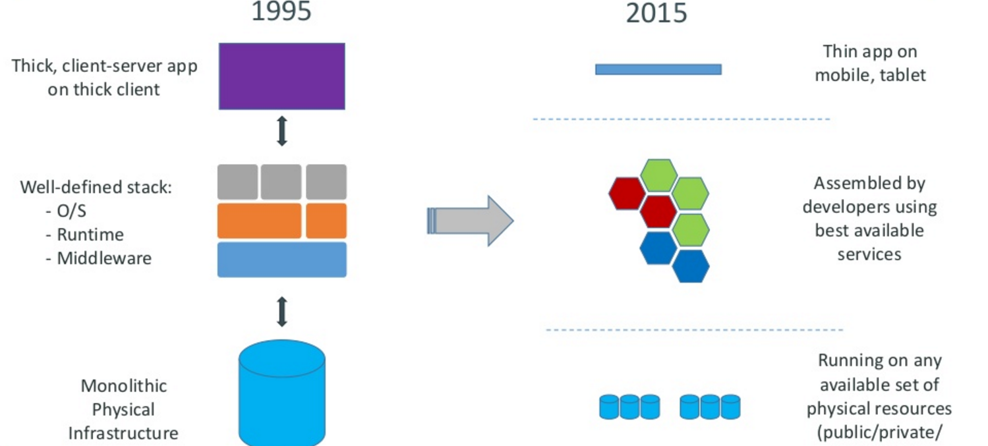
Motivation

Slide 4
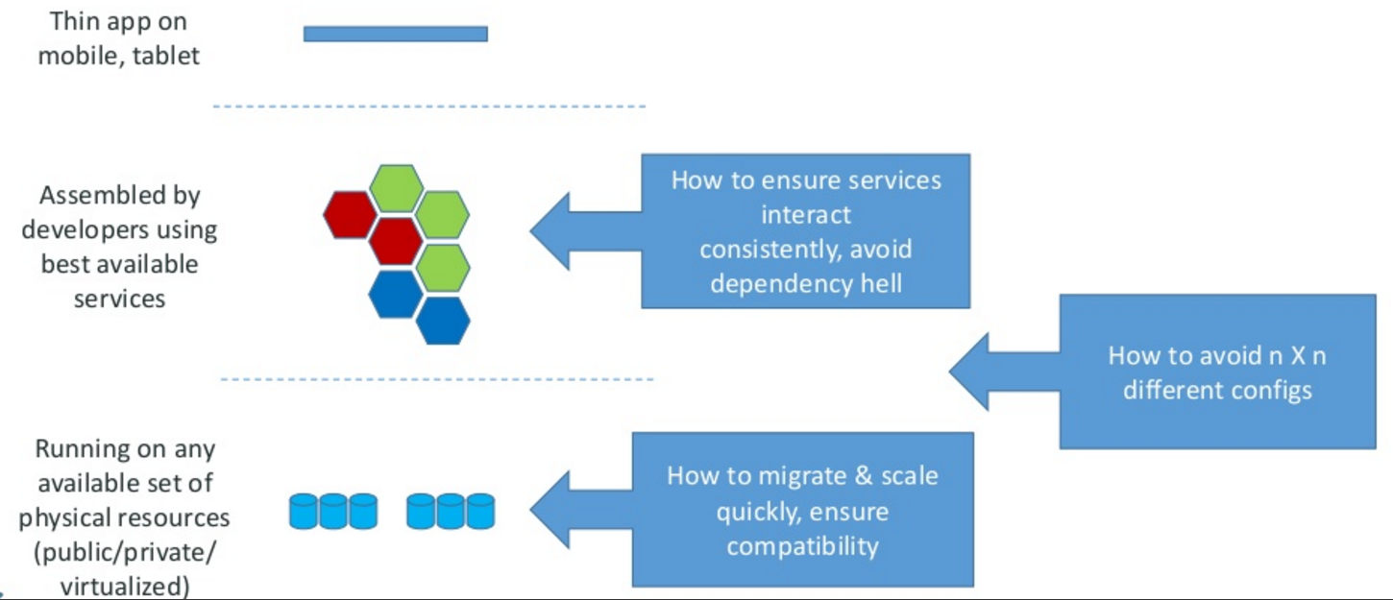
Motivation –the challenge

Slide 5
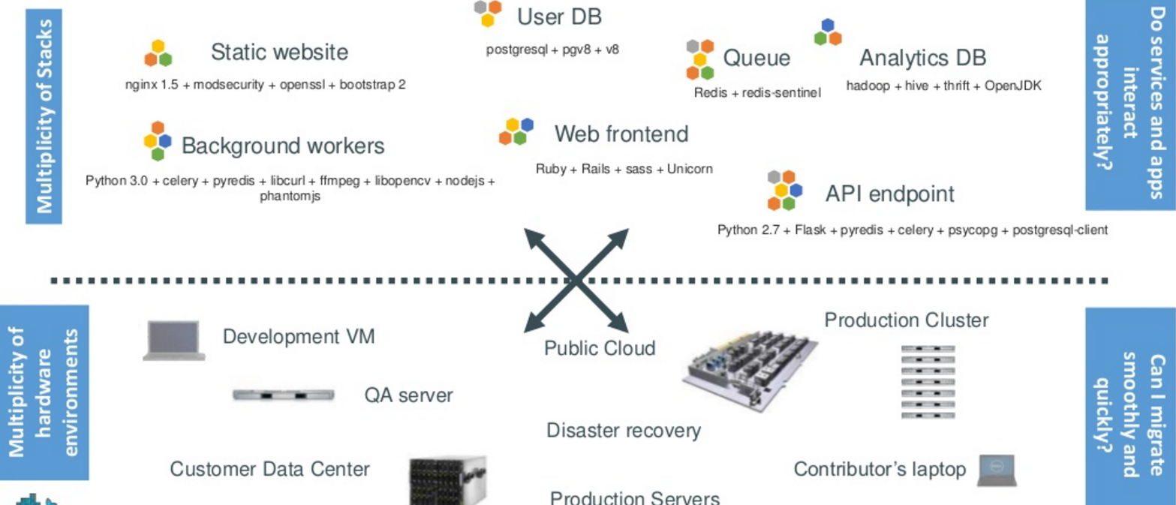
The challenge continued
Notes:
Static web: nginx is a fast webserver, generally faster than Apache
Queue: Redis = in-memory data structure store, used as a database, cache and message broker.
Analytics DB: Hadoop = Hive = Hadoop based Database, Thrift =

Slide 6
PAUSE: What were some of these technologies
Static web: nginx is a fast webserver, generally faster than Apache
Queue: Redis = in-memory data structure store, used as a database, cache and message broker.

Slide 7
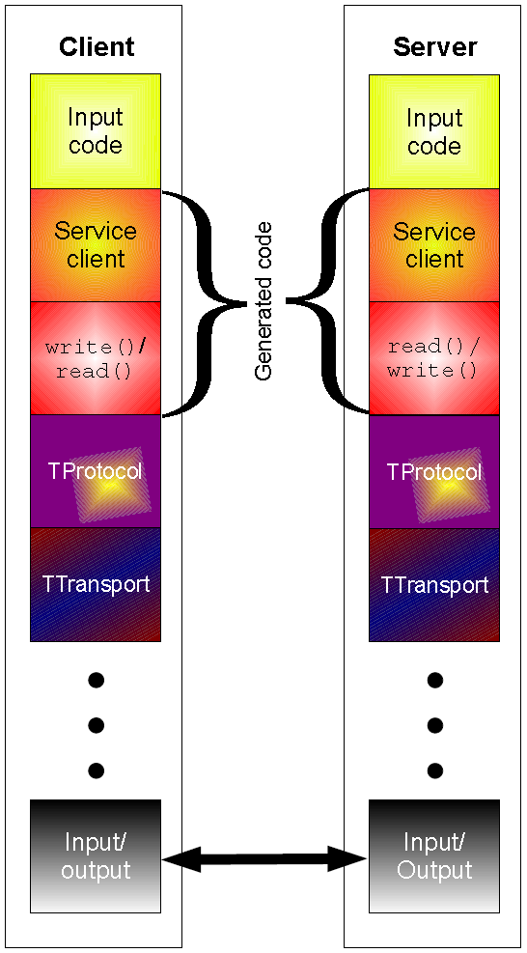
PAUSE:
Analytics DB:
Hadoop = distributed storage and processing of dataset of big data using MapReduce programming model
Hive = Hadoop based Database, offer SQL-like interfaces with HDFS-based data
---allows these database developers or data analysts to use Hadoop without knowing the Java programming language or MapReduce. Now, instead of challenging MapReduce code, you can design a star schema data warehouse or a normalized database.
Thrift = used to define and create services for numerous languages.^{[2]}
It is used as a remote procedure call (RPC) framework and was developed at Facebook for "scalable cross-language services development".

Slide 8
The challenge continued
Notes:
Static web: nginx is a fast webserver, generally faster than Apache
Queue: Redis = in-memory data structure store, used as a database, cache and message broker.
Analytics DB: Hadoop = Hive = Hadoop based Database, Thrift =

Slide 9
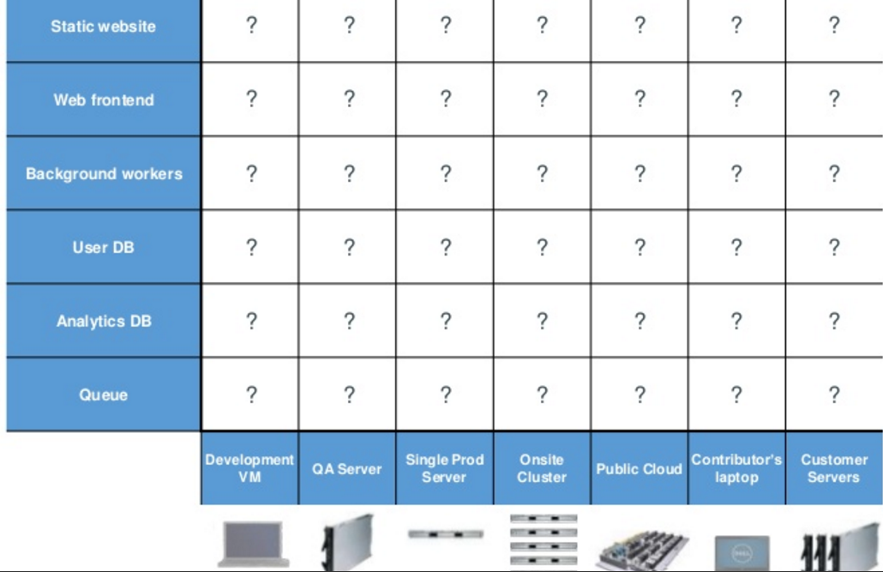
Looking for all kinds of solutions…
Too many to consider

Slide 10
THE ANSWER
Something called a CONTAINER ----which is the business Docker has created.

Slide 11
Huh??? Container
Here is an analogy that Docker use’s to let you understand….

Slide 12
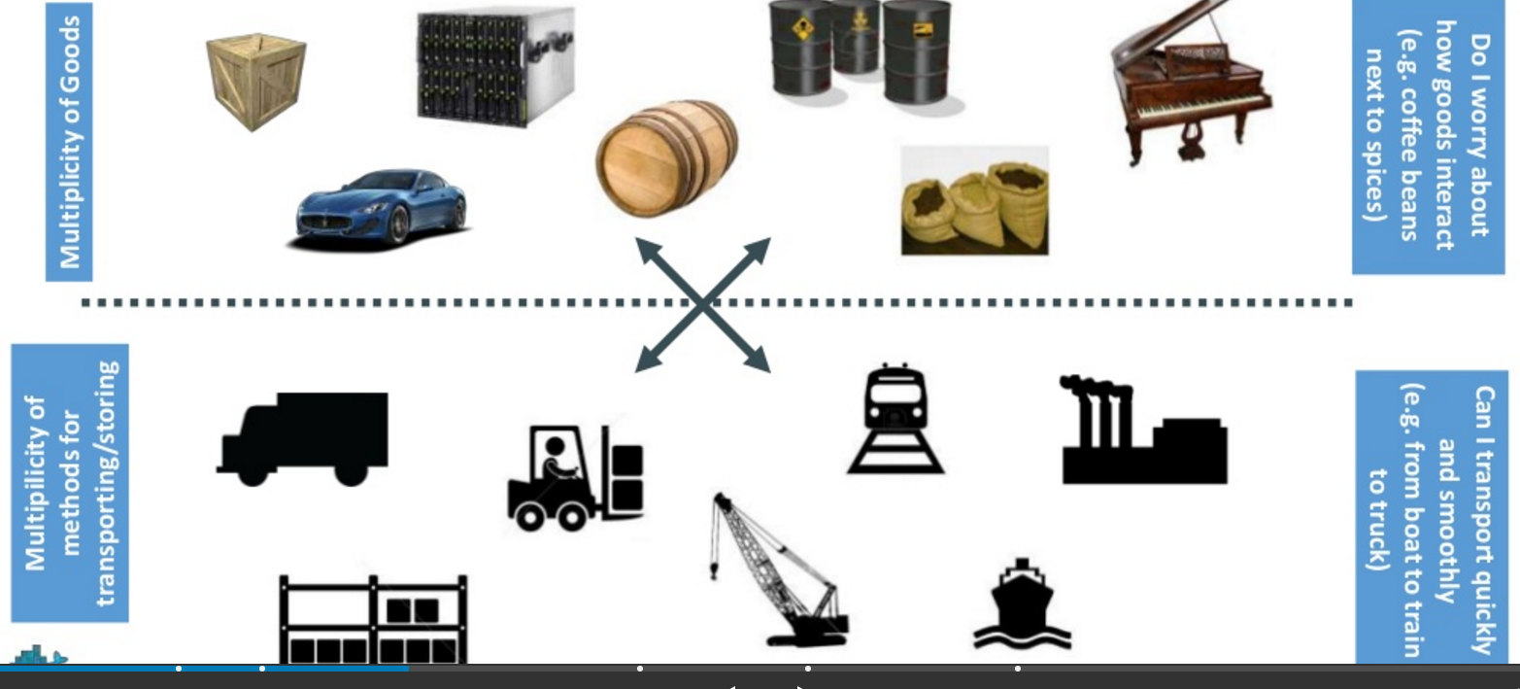
Understanding….an analogy …cargo transport pre-1960

Slide 13
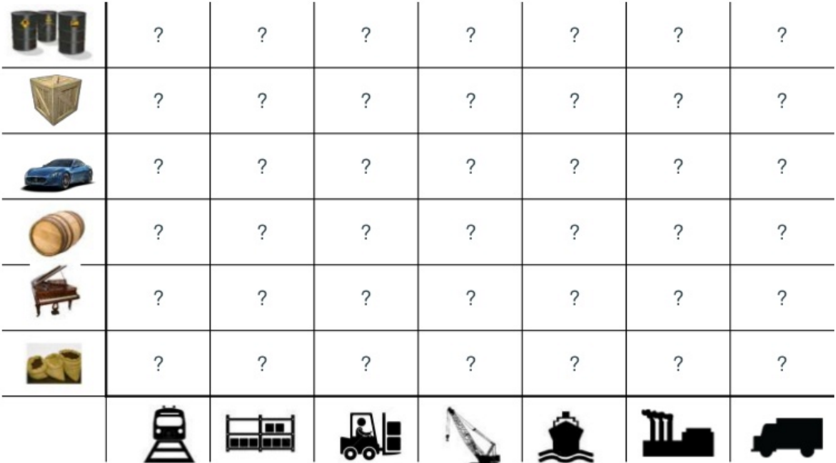
What are the possibilities

Slide 14
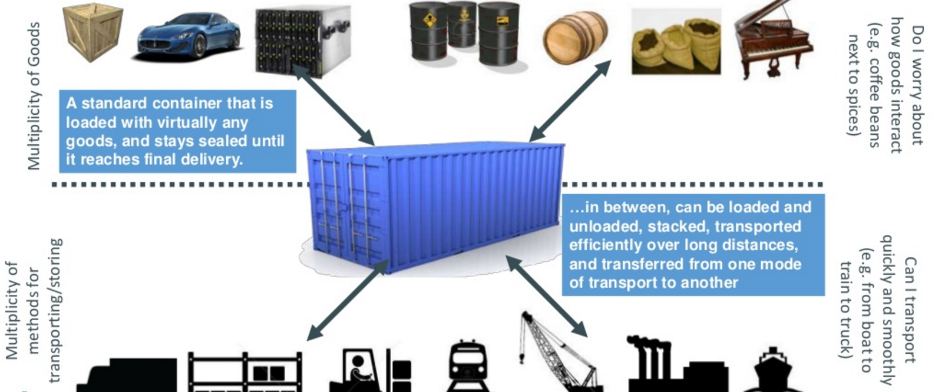
SOLUTION—shipping containers

Slide 15
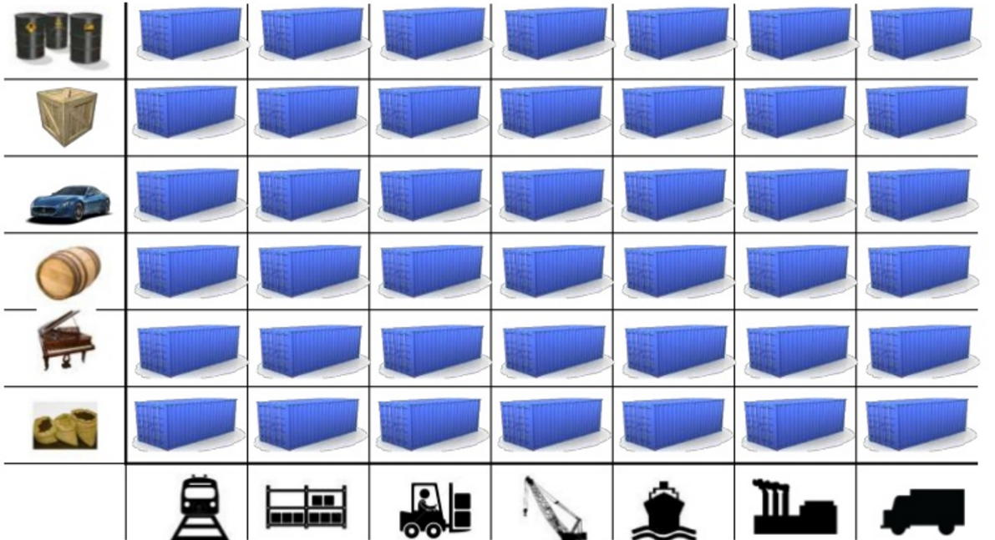
This solved the problem

Slide 16
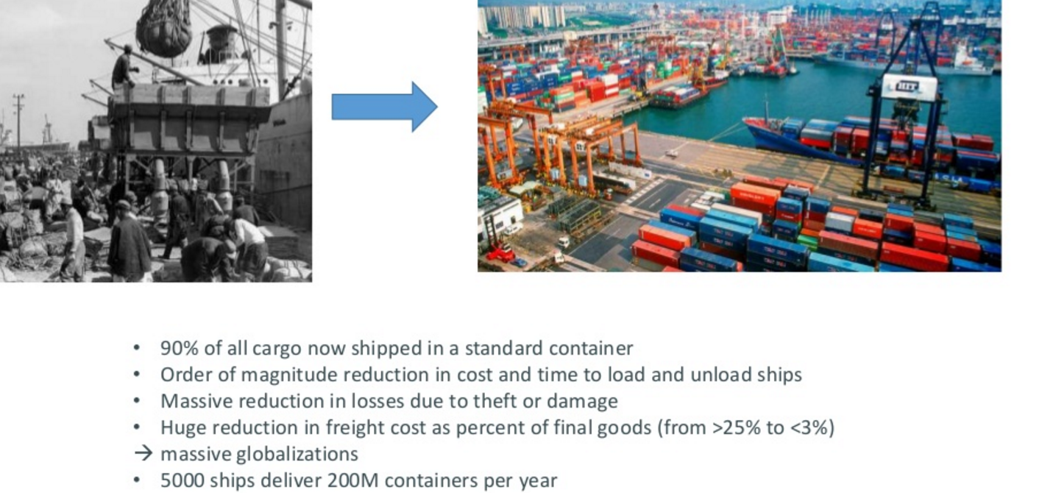
Today shipping is done with containers

Slide 17
How does this container idea translate to our problem

Slide 18
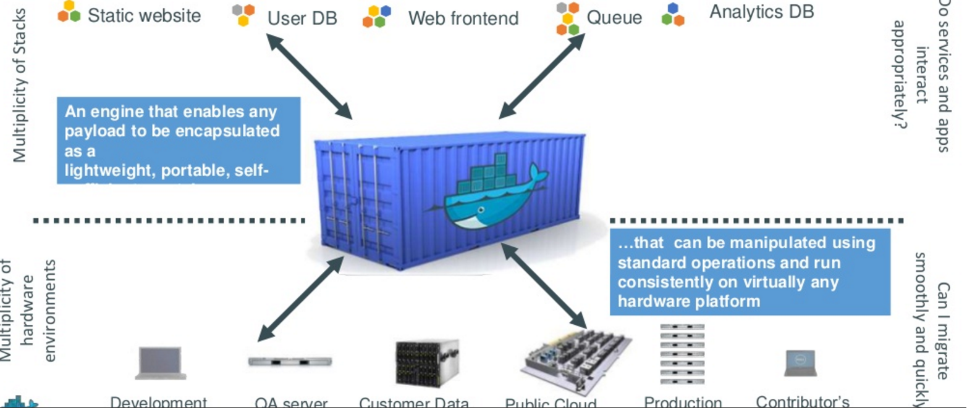
How does this container idea translate to our problem—container for code????

Slide 19
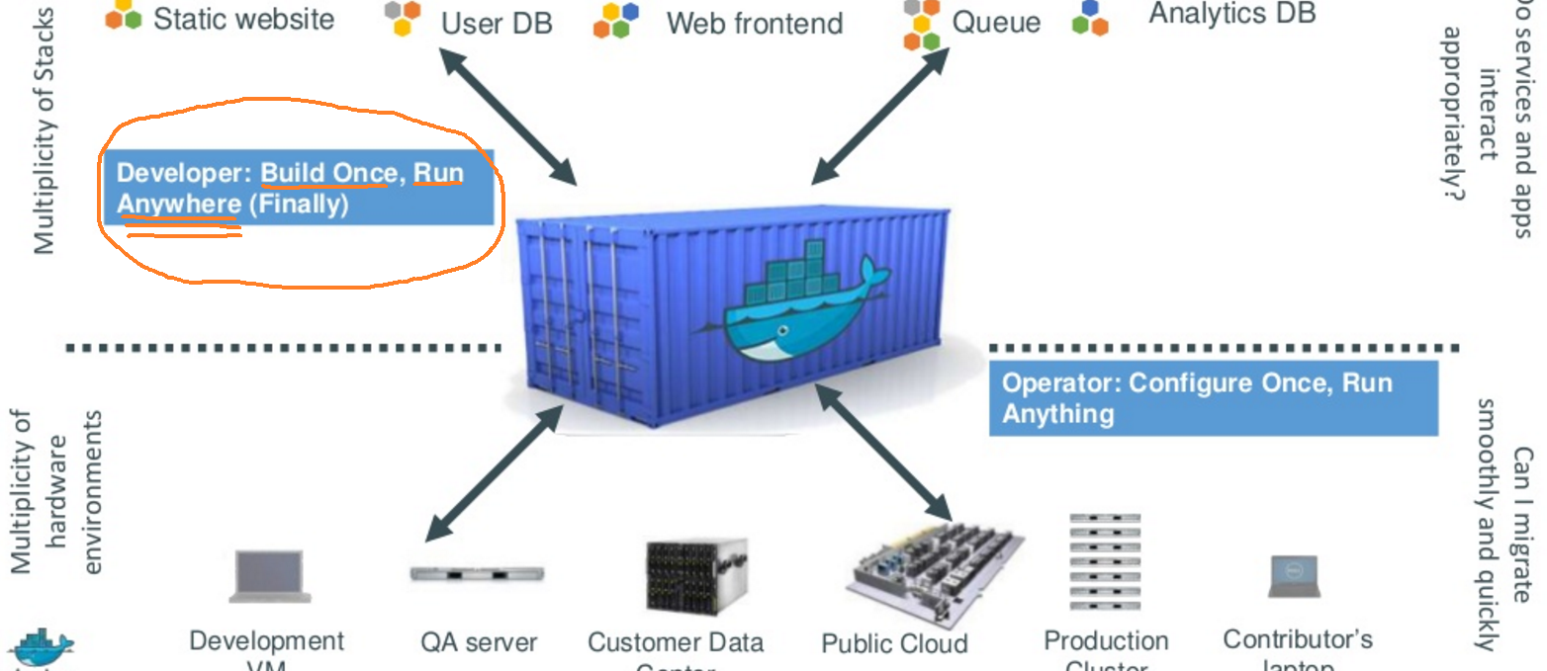
Do once run anywhere

Slide 20
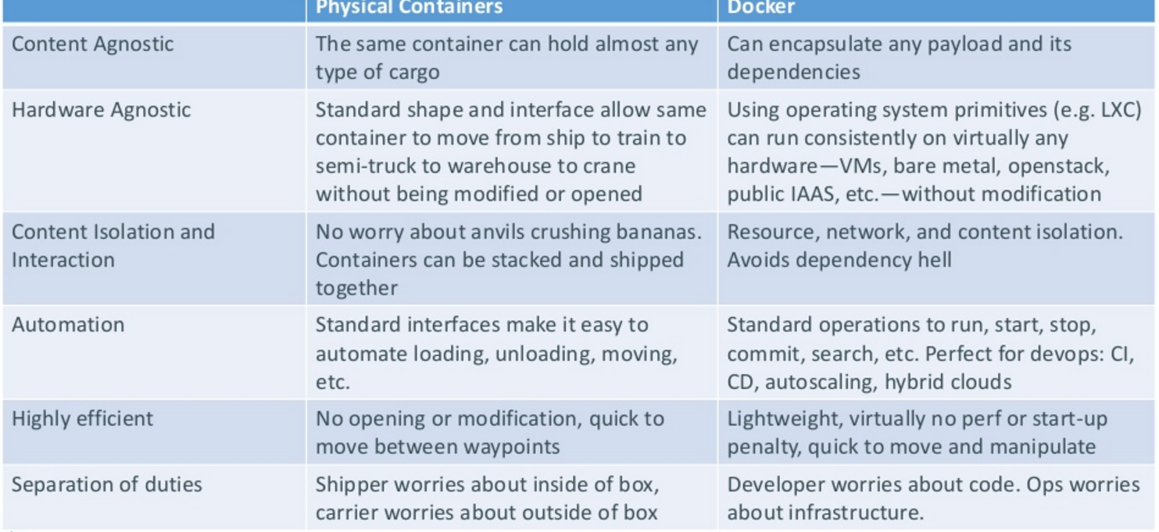
Docker’s container ---the concept (and relation to our shipping container)
CI/CD =continuous integration & continuous delivery
….go here to see on AWS (dealing with automatic builds,etc.)
LXC = linux container technology to run multiple linux on one host, etc.

Slide 21
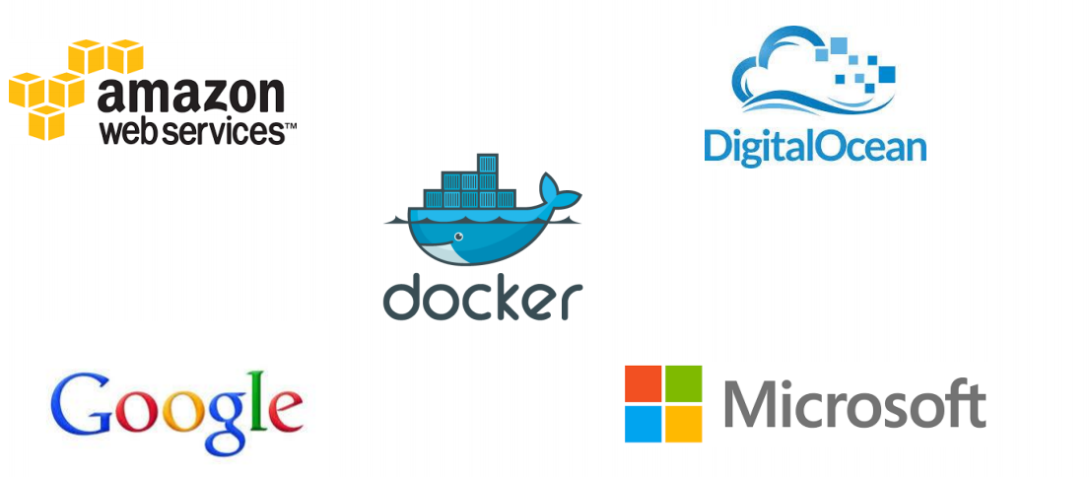
Docker supported in many Cloud platforms

Slide 22
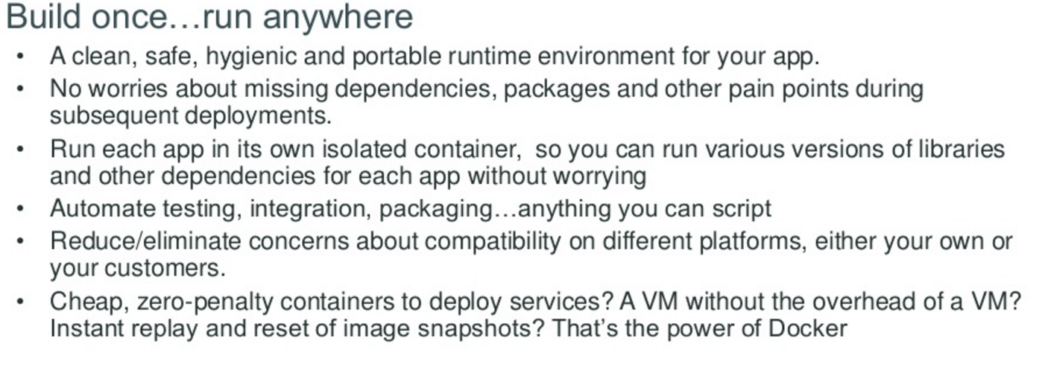
Docker container—developer viewpoint

Slide 23
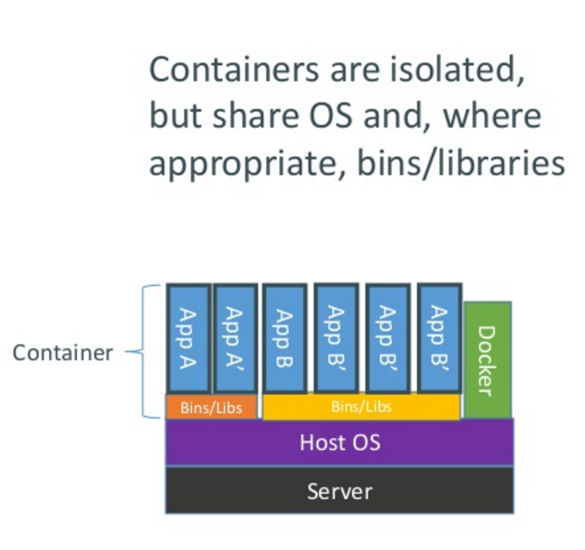
How does Docker containers work?

Slide 24
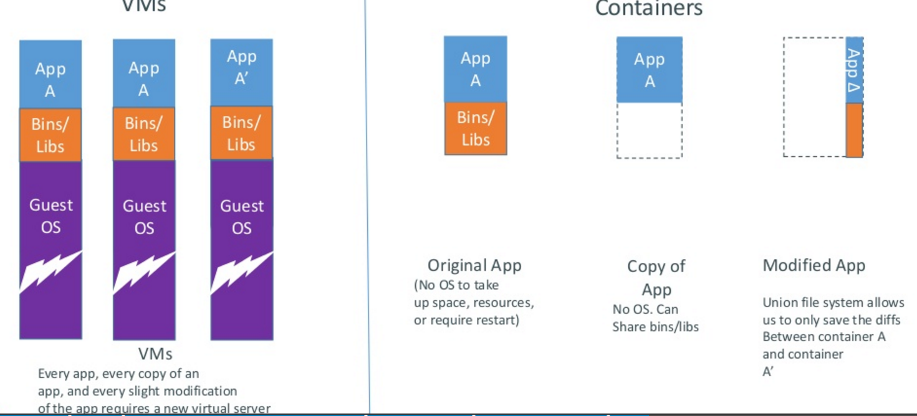
Docker containers are lightweight

Slide 25
WOW –is Docker a PaaS or a replacement for PaaS

Slide 26
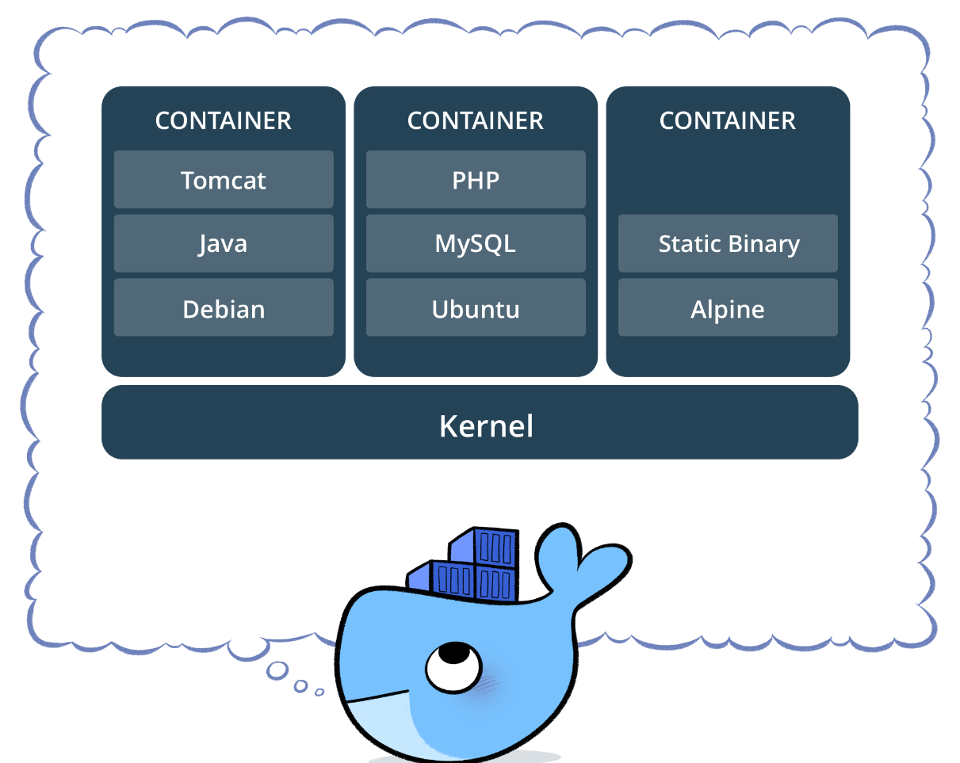
Containers allows users easily to spawn applications on any virtual or physical infrastructure,
integrating all its dependencies such as code, runtime, system tools and system libraries

Slide 27
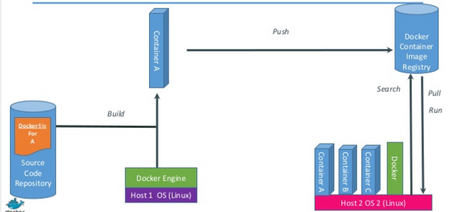
Just how does Docker work

Slide 28
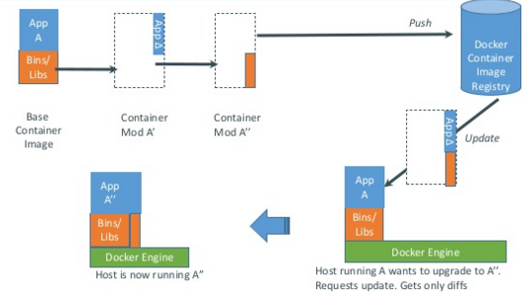
Docker updates/changes

Slide 29
Docker has a repository like github
you can push and pull container images to/from the Docker registry
which is something like a “GitHub” for Docker container images.

Slide 30
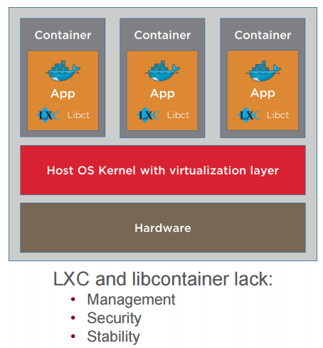
Service providers (public cloud) need containers to run Docker
Docker runs on Containers

Slide 31
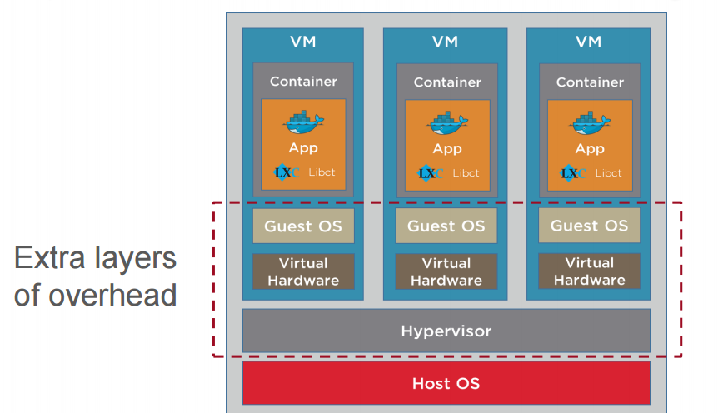
Open source Container inside VM Configuration

Slide 32
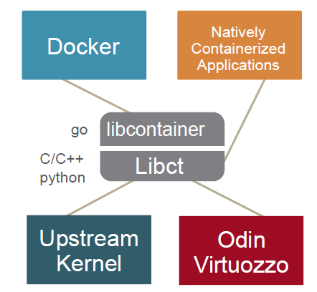
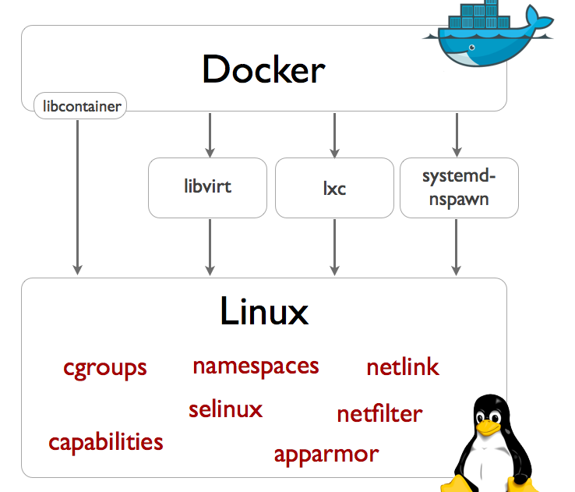
Docker needs containers

Slide 33
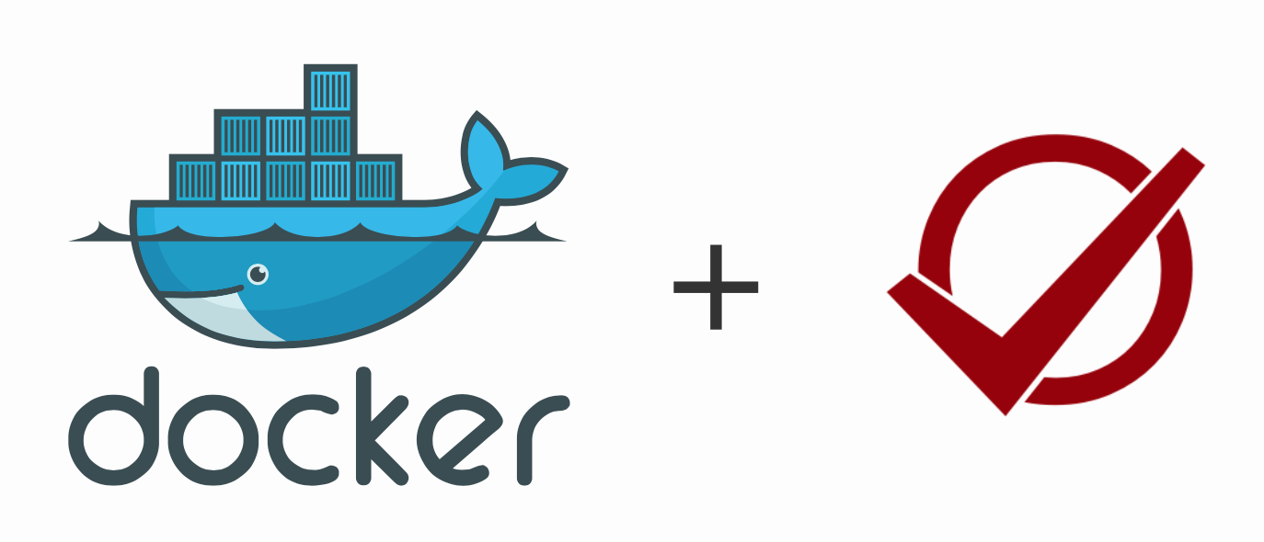
Autolab and Docker?

Slide 34
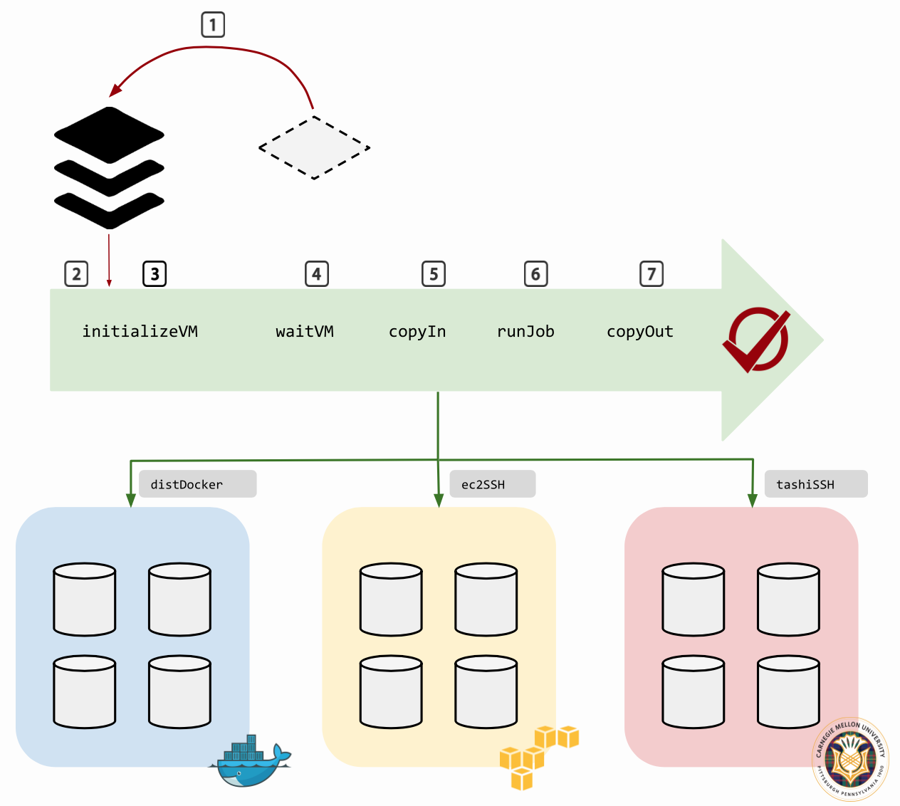

Slide 35
How Autolab Works with Docker
initializeVM - Initializes a VM for that platform.
waitVM - Wait for a VM to be accessible
copyIn - Copy all necessary input files to run the job.
runJob - Invoke the autodriver to run the job. The autodriver instruments the job, runs it in a controlled environment and restores the system state after job completion.
copyOut - Copy feedback file from the VM.
destroyVM - Destroy a given VM.
getVMs - Get a list of VMs in each VM pool.

Slide 36
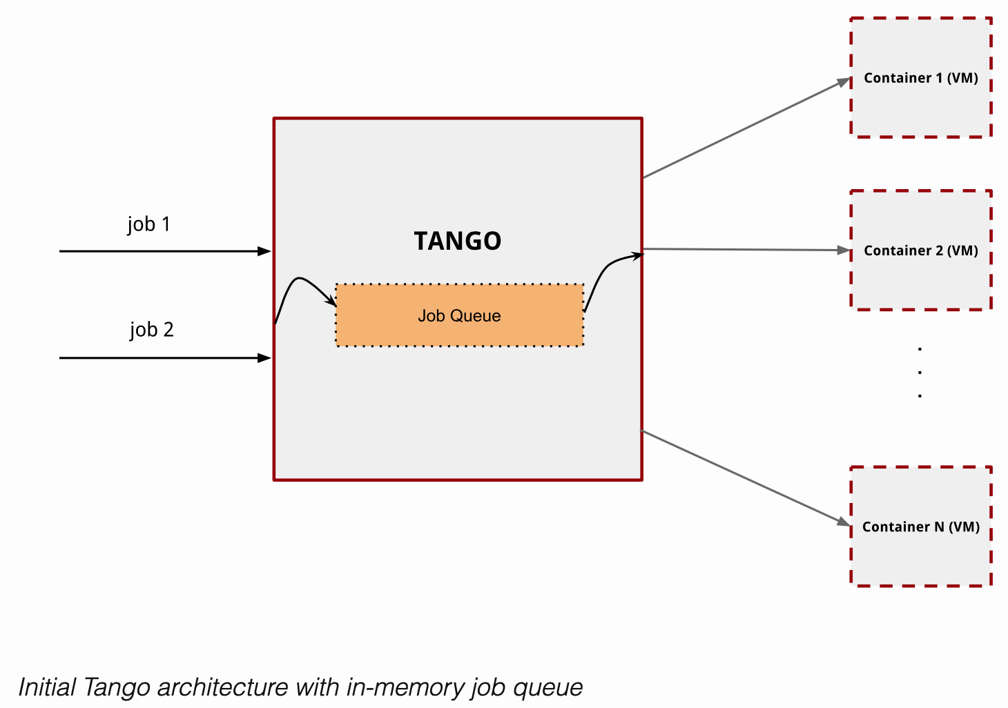
How Does Autolab Grade an Assignment?

Slide 37
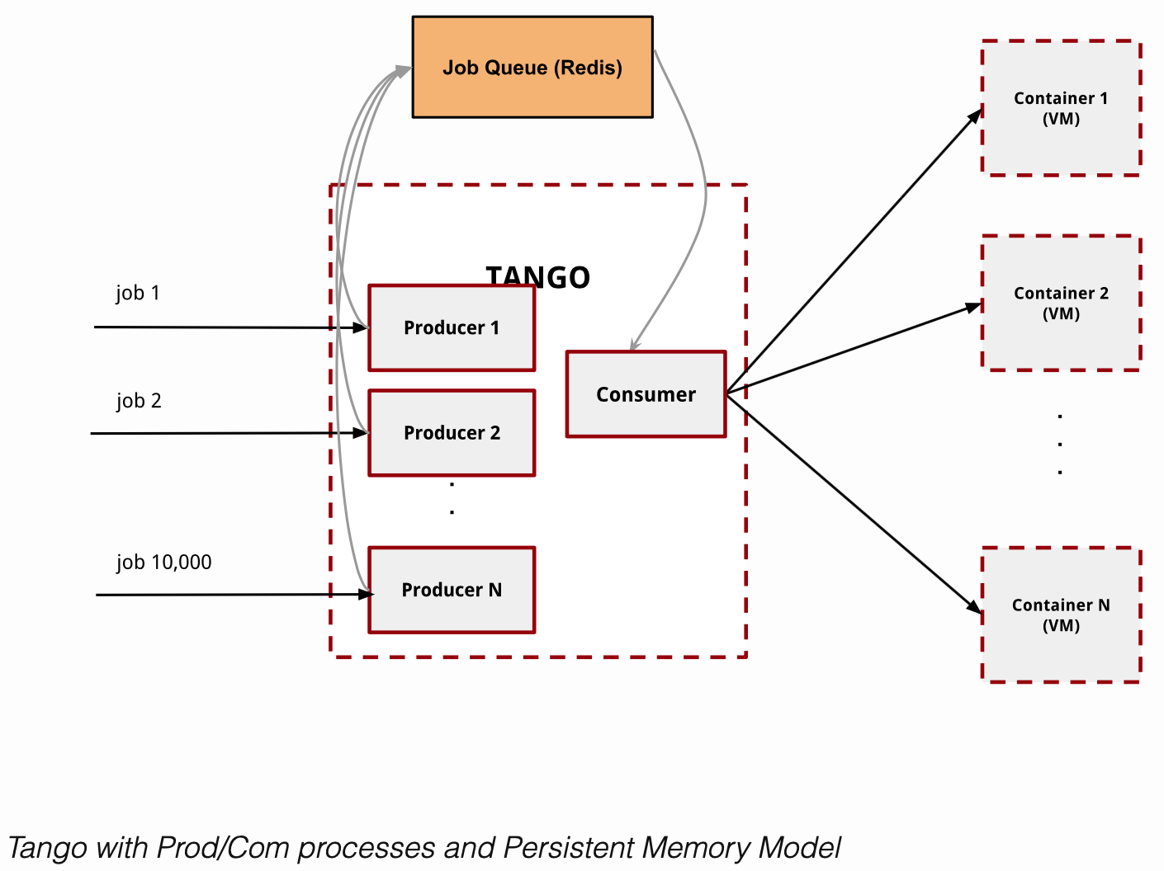
How Does Autolab Grade Many Assignments?

